Slide 1

Sustainable Energy as a Service
For the Public Sector

Slide 2
Agenda
1. The benefits of Sustainable Energy as a Service for ESCOS and motivating factors for customers
2. Sustainable energy-as-a-service detailed structure and key project contracts
3. Illustration of cash flow for customers and ESCOs
4. The similarities and differences between traditional energy performance contracting
5. Frequently Asked Questions & Participant Questions

Slide 3
Sustainable Energy as a Service Benefits
Why and Where the solution works best

Slide 4
Benefits to ESCOs
4
Increased
Deal Size
Pathway
to Scale
Recurring
Revenue
New
Opportunities
  By covering 100% of upfront cost, sustainable energy as a service (SESA) enables customers to pursue larger projects
  The SESA is a flexible structure that can be replicated at other facilities
  The SESA contains
  long-term O&M and
  M&V contracts for
  the contractor
  Engagement in long-term relationship creates opportunities for new projects

Slide 5
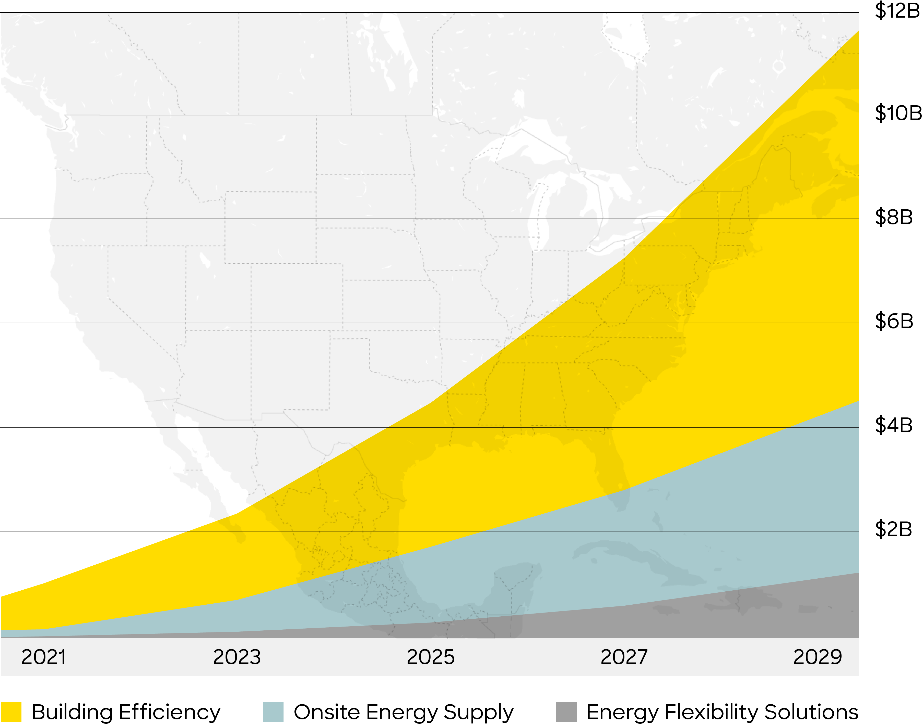
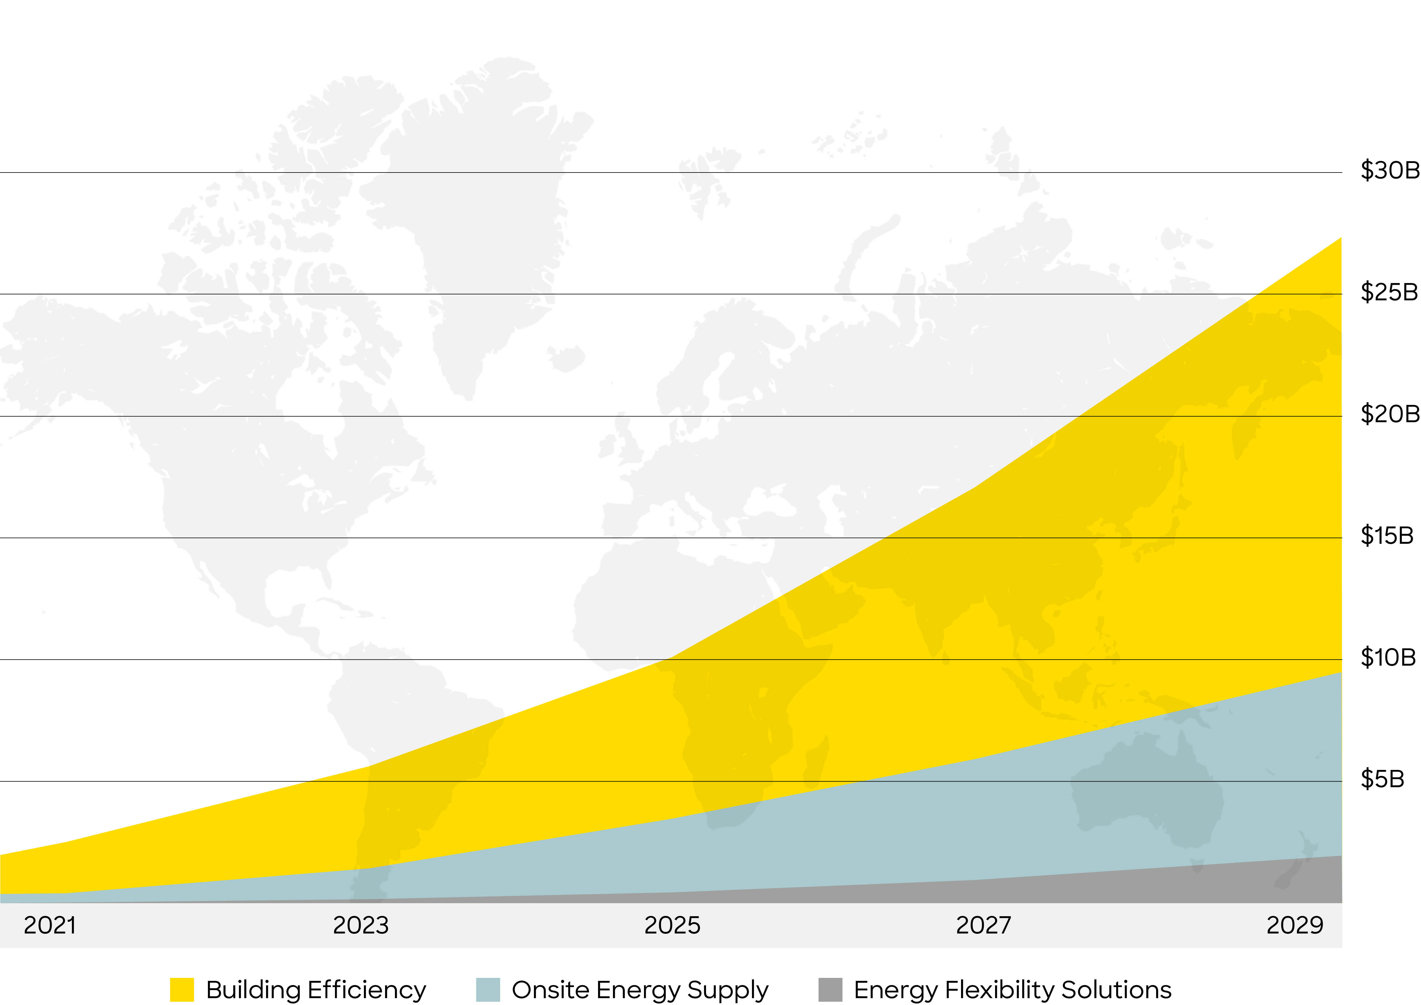

The Large and Growing Market for Energy as a Service Financing
North America is expected to account for nearly $12 billion of the total EaaS financing market in 2029
By 2029, the total global market for EaaS financing will be approximately $27 billion
North American Market
Global Market

Slide 6
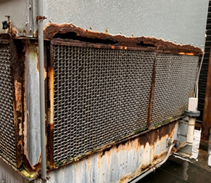
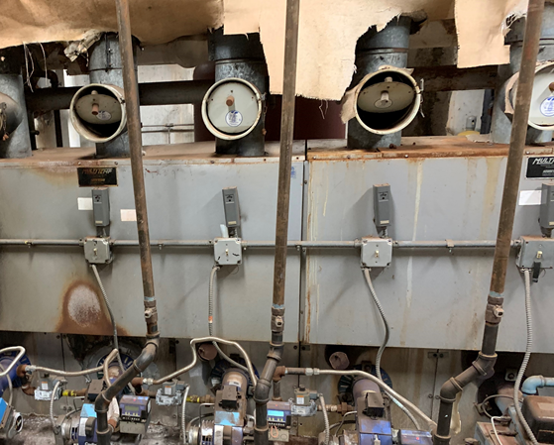
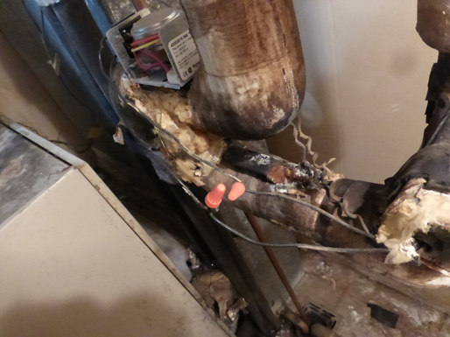
General Customer Benefits
Zero capital outlay and off-balance sheet accounting treatment
Cashflow positive from day one (SESA rate is set below current utility rate)
Flexibility to address critical deferred maintenance
Allows organizations to focus their capital and resources on core business operations – Why use your money when you can use Energy as a Service Provider’
Sustainability achievement (annual reporting)

Slide 7
Public Sector Customer Benefits
Using the SESA can help preserve bond dollars for critical projects instead of paying for lightbulbs.
Public sector customers do not have access to unlimited tax-exempt debt. There are statutory and policy limits to how much they can issue. Using a SESA helps preserve their debt capacity for other projects that might be more expensive.
Public sector customers are already very familiar with PPAs and third-party ownership. It should make the initial conversations easier.
Although COVID relief funds are providing some capital they are likely not to include everything a customer would need and can be used as “prepayments” to enable a larger project. It can be used as the equivalent of a gigantic incentive’

Slide 8
Sustainable Energy as a Service Structure
Development & Key Project Contracts

Slide 9



Sustainable Energy as a Service Typical Contracts
Energy as a Service Provider
SESA
ESPC
Customer
ESCO
Financier funds 100% of project cost, owns the equipment, and pays for maintenance and monitoring. Customer pays for measured savings and clean energy output
Financier contracts with the ESCO (contractor) to design and construct the project as well as to provide ongoing services

Slide 10



The Development Process
Develop
Implement
Operate
Evaluate the existing infrastructure
Identify potential sustainable energy measures
Agree on a scope
of work with Energy as a Service Provider and the customer
Perform Investment Grade Audit (IGA)
Financier pays ESCO 100% of construction costs
Customer receives all savings during construction period
Project is complete after a review by Energy as a Service Provider and the Customer
On-going measurement & verification included in the service fee and paid to the ESCO
On-going operations & maintenance included in the service fee and paid to the ESCO
Opportunity for additional tranches with the customer

Slide 11
Project Cash Flows
Example project cash flow for customers and ESCOs

Slide 12
Sample SES Project: Deal Characteristics
EaaSP Project Management Costs ($/yr)

Slide 13
Customer Cash Flow

Slide 14
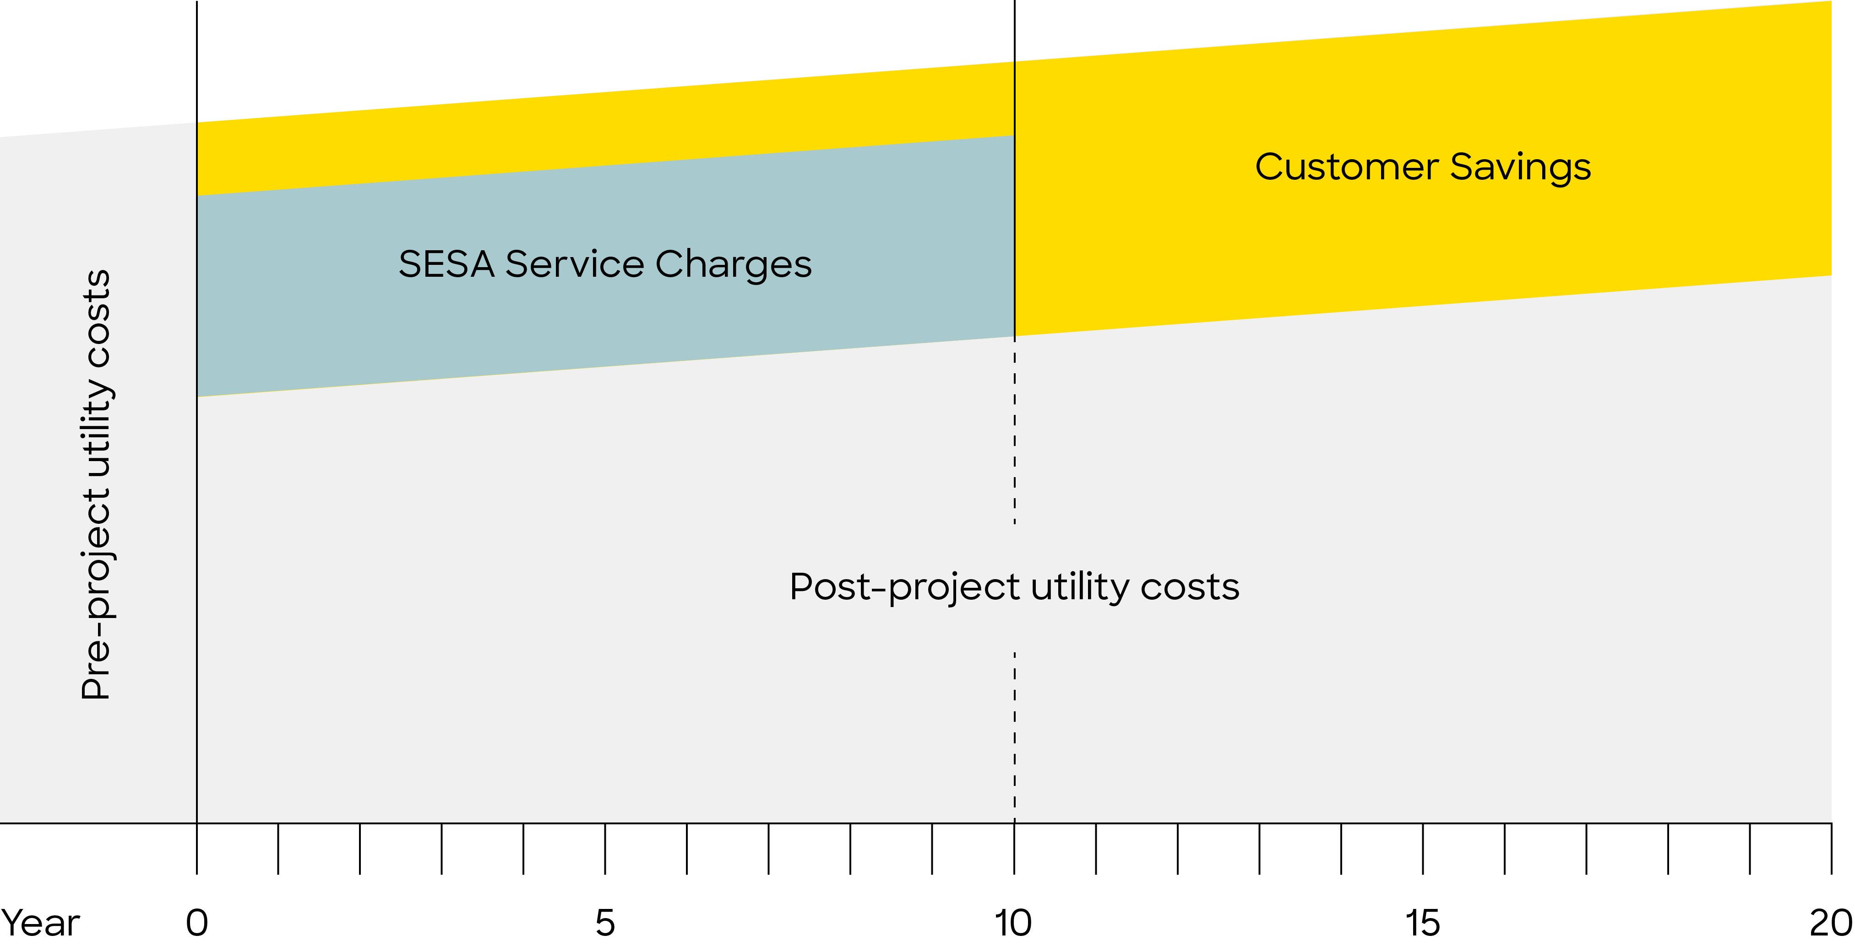

Customers Remain Cash Flow Positive
All project development costs are funded by Financier
Customers remain cash flow positive for the duration of the contract
During the contract term ESCO is paid for project maintenance and monitoring the cost of which is part of the service fee and shared savings
After the project term and fair market value buy-out the customer receives 100% of savings

Slide 15
Differences & Similarities
Similar Core Elements with Key Differentiators

Slide 16
SESA vs ESPC
Similarities & Differences
Performance Contracts are still a part of the core of Energy as a Service
Energy as Service underwrites to 100% of expected savings compared to typical 90% Guarantee. Financier takes first loss position and additional risk on behalf of the customer and ESCO
Third-Party Ownership means that project oversight and on-going management of services handled by “As a Service Provider” instead of customer
Payments by the customer are considered off-balance sheet per Governmental Accounting Standards Board (GASB) as opposed to traditional debt
Customer payments are pro-actively adjusted based on-going measurement & verification and payments adjusted via an annual true up.

Slide 17
Other Key Differences Between Energy as a Service and Tax-Exempt Financing
Key Attributes | Energy-as-a-Service | Tax-Exempt Financing
Cost/fees | No, No payments are due until the project is operational and savings start being realized | Yes, Closing costs
Environmental Incentives/Rebates | All incentives and rebates are taken on customer’s behalf and incorporated into project to drive down total cost | Customer secures incentives and rebates
Operations and Maintenance | Energy as a service funds and manages asset O&M and M&V and bears asset performance risk | No, Customer is responsible
Periodic Payment Obligation | Variable pay-for-performance | Fixed payment schedule
End of Term Options | Flexibility – Purchase at fair market value, return equipment or extension | None

Slide 18
Frequently Asked Questions
Typical ESCO & Customer Questions

Slide 19
FAQs
How is the SESA off-balance sheet?
How are SESA payments set?
The SESA is a service agreement for the delivery of energy savings/generation not a lease.
Assure customers that service agreements like SESAs are off-balance sheet under FASB ASC 842 and offer to set up a call with Energy as a Service Provider to walk through accounting treatment.
Key factors in off-balance sheet accounting treatment include economic benefit, ownership, and control.
SESA services charges are set as a cost per unit of energy saved utilizing an SESA rate (e.g., $/kWh)
Service charges are set at or below a customer’s existing utility rates, resulting in reduced operating expenses for customers.

Slide 20
FAQs
What happens at the end of the SESA Term?
How do changes in operations affect savings calculations?
At the end of the SESA term, the customer has the option to renew the agreement or purchase the equipment for its fair market value.
During the development process of the detailed energy assessment, we work with your facility staff to fix and agree upon key baseline operating parameters to the savings calculations like operating hours, production levels and occupancy. These inputs are agreed upon and fixed prior to contract signing. In this way, equipment efficiency is measured without worrying about changes in day-to-day operation that are outside of Energy as a Service Provider’ and our ESCO’s control.

Slide 21
FAQs
Do SESA rates fluctuate with my utility rates?
Other Questions?
No. SESA service charges are set at contract signing and then escalate each year at an agreed up escalation rate (similar to a solar PPA).
The SESA escalation rate remains the same whether actual utility rates increase or decrease over time.

